Slide 1

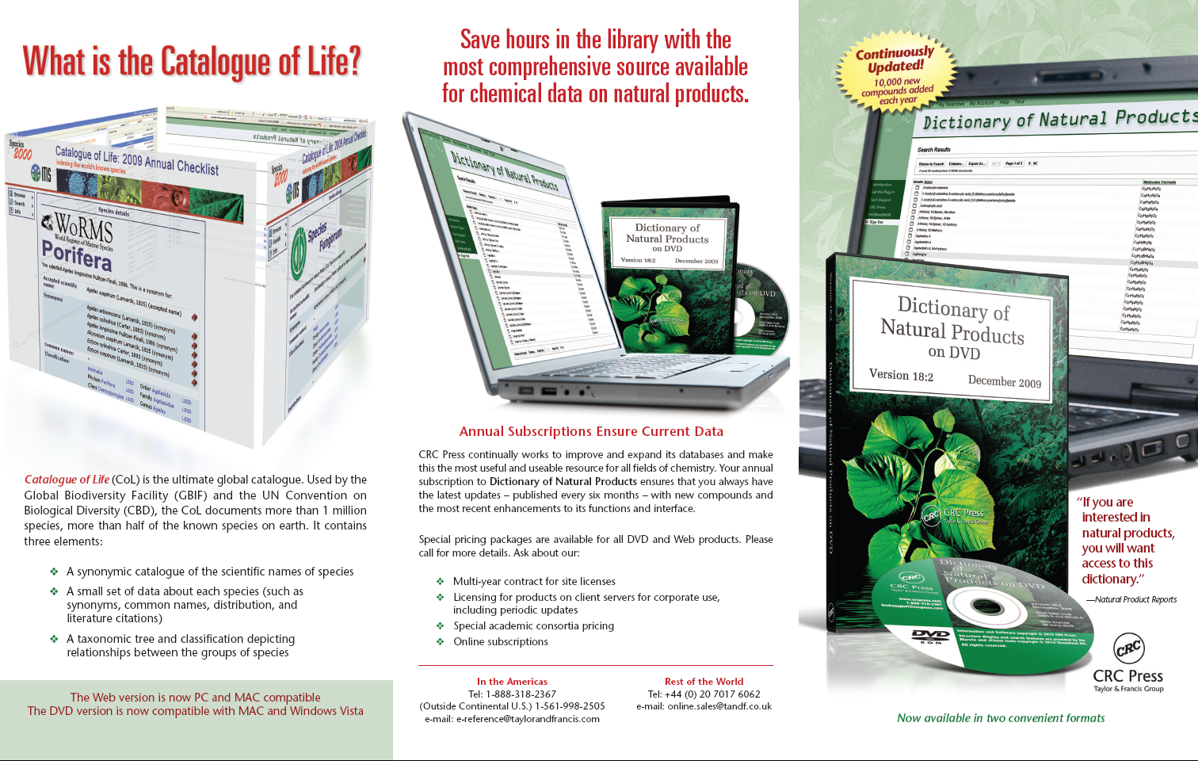
Towards sustainability for the Catalogue of Life:
Advertising materials - the first CoL Commercial Contract

Slide 2
